Slide 1
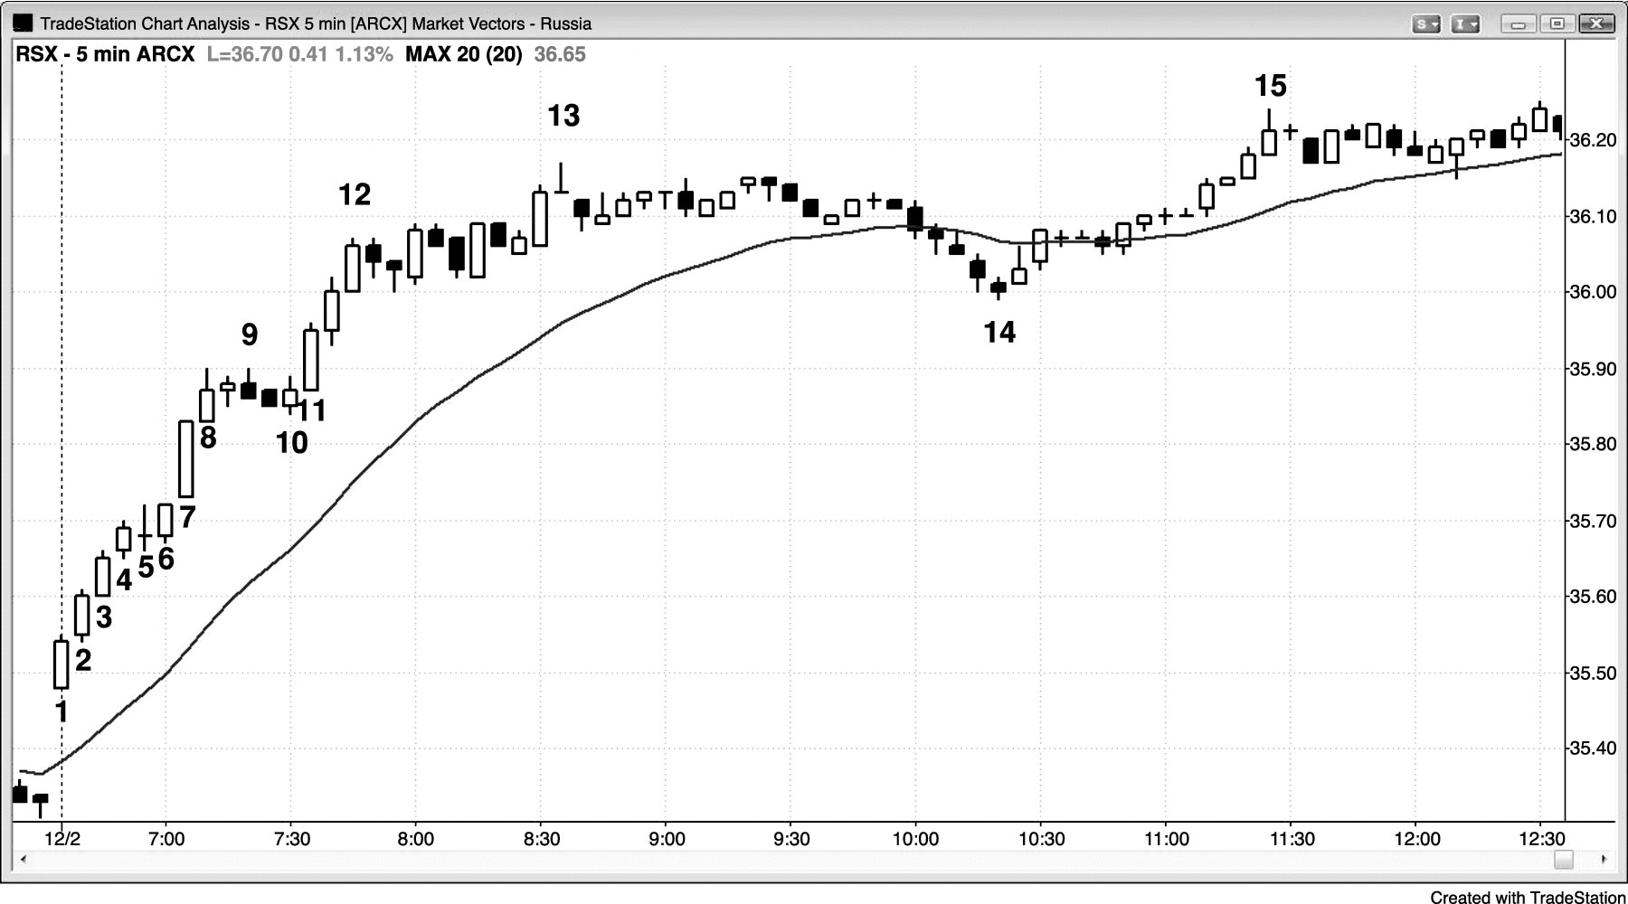
FIGURE 3.1 Breakouts with Many Consecutive Trend Bars Are Usually Strong

Slide 2
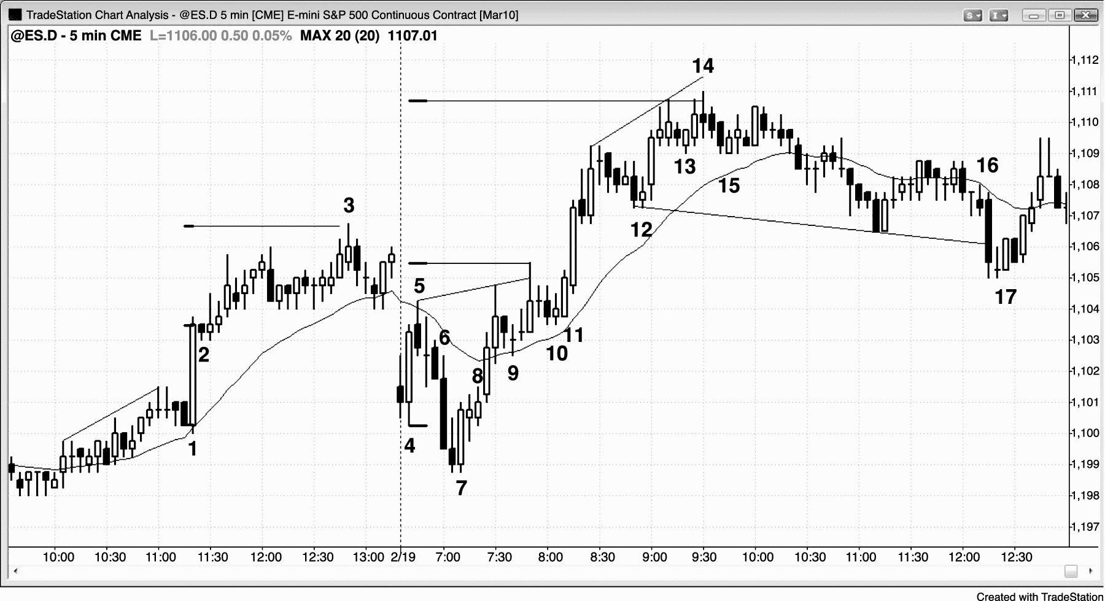
FIGURE 3.2 Successful Breakouts Need Follow-Through

Slide 3
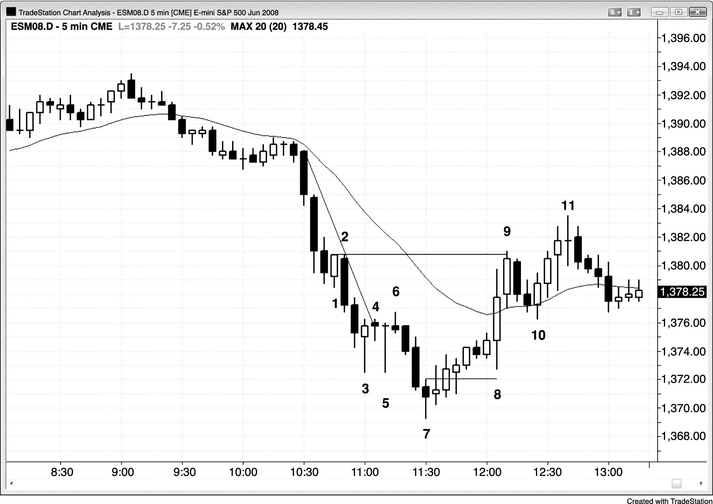
FIGURE 3.3 Watch Charts and Not the News

